Slide 1

Software Testing

Slide 2
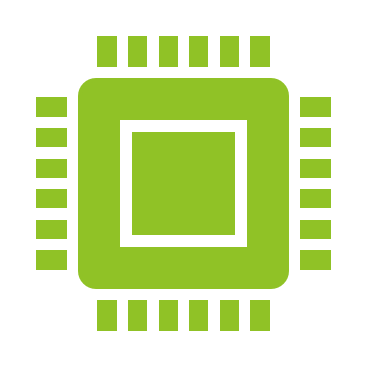
Software Testing Overview
Software testing is the process of check the working of the software.
It is the process of verification and validation of the software to check whether it is working as per the expectations.

Slide 3
Purpose of the Software Testing
To find the defects or bugs in the software with the positive intension of improving the quality of the software

Slide 4

Why Software Testing is Required?
Buggy software with less quality may got released into the market.
Business reputation will be lost.
Customer may file a case in court.
Sales may got dropped.
Revenue Loss.
Loss of Life.

Slide 5
Basic Testing Types
Manual Testing
Automation Testing
Desktop App Testing
Web App Testing
Mobile App Testing
UI Testing
API Testing
Database Testing
Performance Testing
Security Testing

Slide 6
Verification and Validation Process
Verification Testing with the help of requirements or user guide.
Validation Testing is based on end user is satisfied with that or not.

Slide 7
Entry and Exit Criteria for Testing
Entry Criteria: Entry Criteria gives the prerequisite items that must be completed before testing can begin.
Exit Criteria: Exit Criteria defines the items that must be completed before testing can be concluded
Requirement Analysis
Test Planning
Test Debugging
Test Execution
Test Closure

Slide 8
SDLC-Software Development Life Cycle
Requirements Gathering and Analysis
Design
Implementation
Testing
Deployment
Maintenance

Slide 9

Requirements Gathering and Analysis
BRS document which is created by BA is called Requirement Gathering and Analysis.
BRS-Business Requirement Specification Document
BA- Business Analyst

Slide 10
Design
To see the testing tools technical disabilities and do the Technical analysis and create a SRS document.
Based on the SRS document they will plan design with Low level design and High level design plan [Architecture level and UI level design plan]
SRS-Software Requirement Specifications

Slide 11

Implementation
Based on BRS, SRS, Design plan, the development team write the code and develop the software

Slide 12
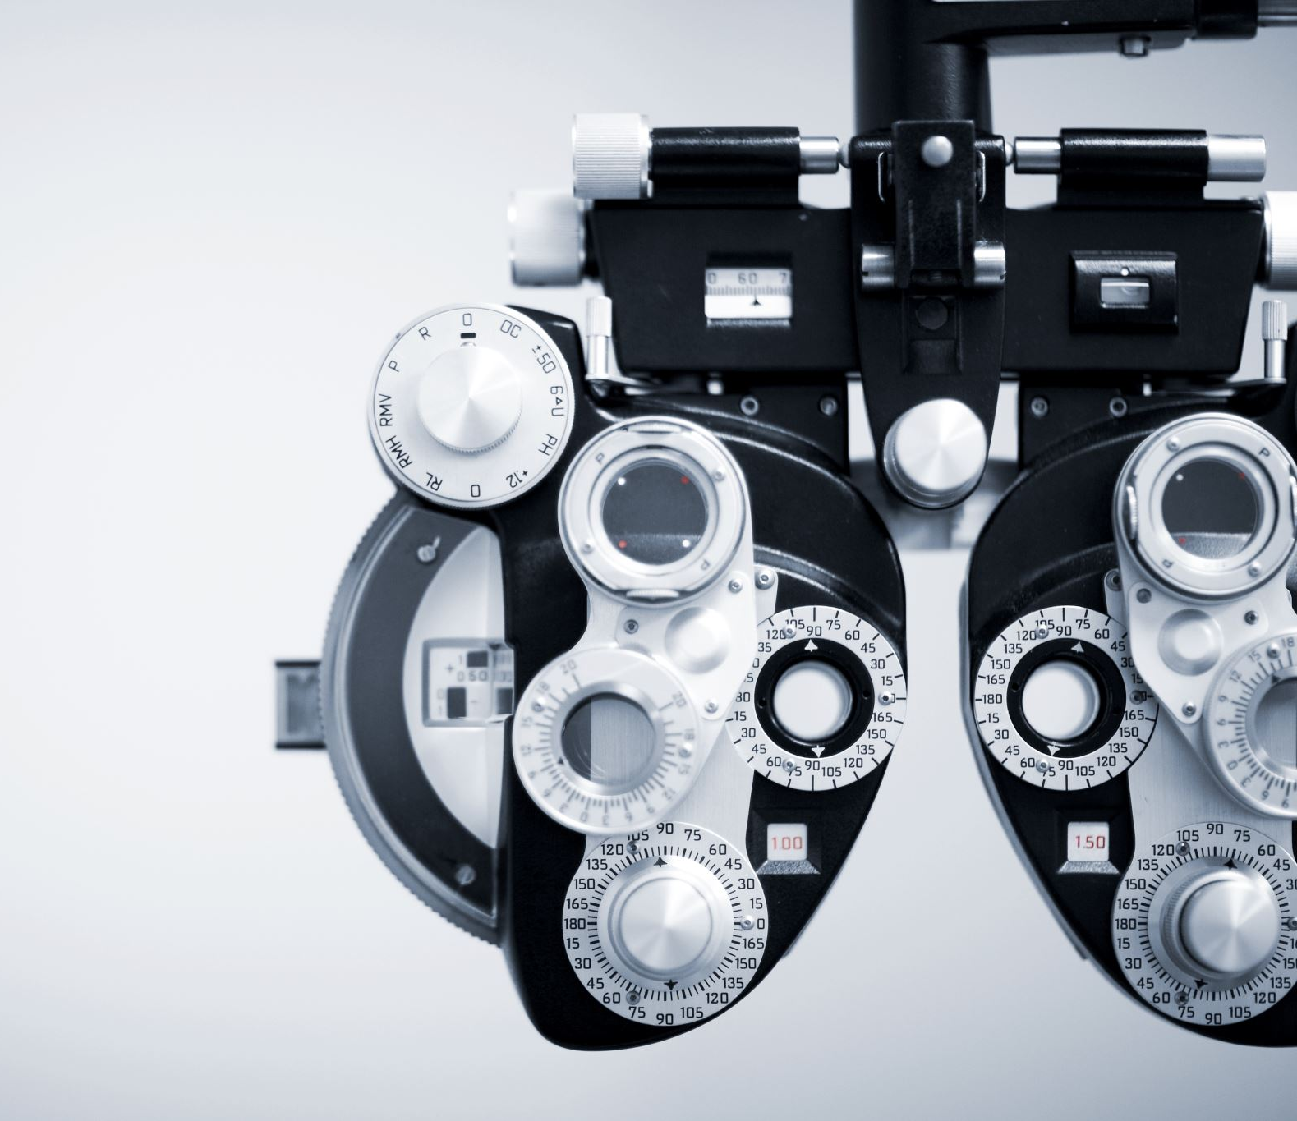
Testing
To check the developed software is according to the user needs and as per the requirements or not.
Then they will do
Test Plan
Test cases
Test Reports
Defects Reporting
Retest
Test Close

Slide 13

Deployment
Once the testing is completed and the software is stable, then they move the software to deployment process and deployed the software to production environment.
Then the software is released in the market.

Slide 14
Maintenance
If any new requirements and functionalities, then they will include in this stage.

Slide 15
SDLC Models
Waterfall
Prototype
Iterative and Incremental
Spiral
V
Agile
RAD
Bigbang

Slide 16
STLC-Software Testing Life Cycle
Requirement Analysis
Test Planning
Test Designing
Test Execution
Test Closure

Slide 17
Manual vs Automation Testing
Manual Testing
A person will be performing the Testing without using any tools.
Automation tool will replace the person.
With the help of code, they will do the testing
Automation Testing

Slide 18

Questions?

Slide 19

THANK YOU

